Slide 1

EXPLORING LONDON
PREDICTING HOUSE PRICES USING FOURSQUARE LOCATION DATA

Slide 2
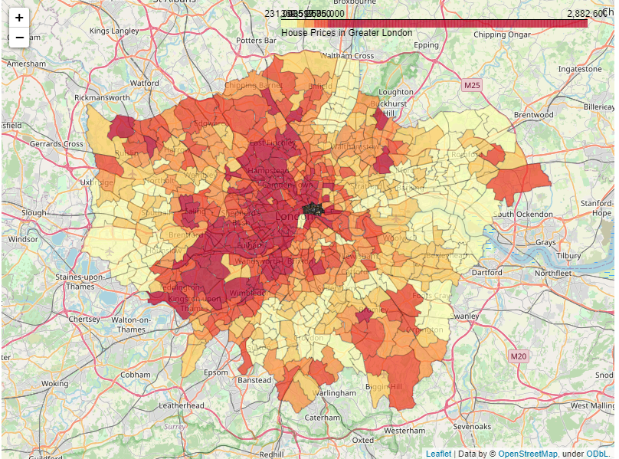
LONDON HOUSE PRICES
Obtained house price statistics from London Datastore for each London Ward (the smallest administrative division) – using December 2017 values.
Categorised average London house prices into equal sized bins from lowest (pale yellow) to highest value (dark red)
  The highest quantile has by far the largest range of prices, from around £640,000 to over £2.8 Million
Highest values are in the city centre, and the south-west quadrant of Greater London.

Slide 3

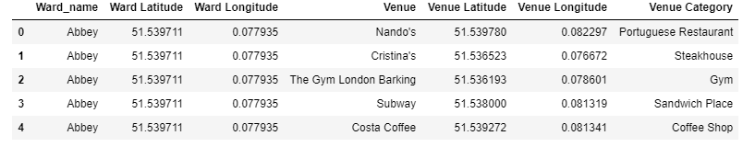
FOURSQUARE DATA
For each ward we queried Foursquare’s Developer API for the first 100 venues within 500m of the Ward’s centre point
We were then able to collate the venue categories into the top 10 venue categories for each Ward

Slide 4
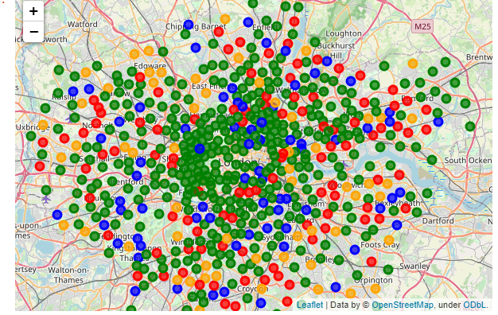
Finding Similar areas within the City
We used a form of unsupervised machine learning, K-means clustering, to split London Wards into 4 clusters based on the frequency of the top 10 venue types in each ward.
Cluster 1
Cluster 2
Cluster 3
Cluster 4

Slide 5
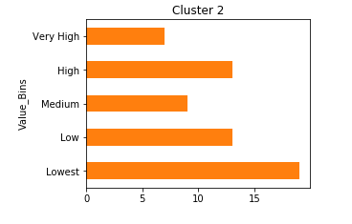
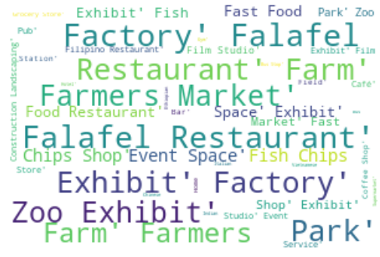
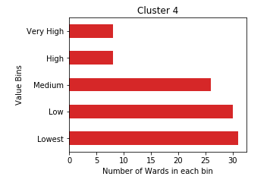
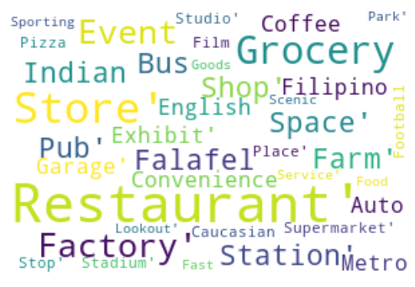
House prices lower near Factories
Clusters 2 and 4 showed similarities in that both skewed towards low value properties, and both featured factories

Slide 6
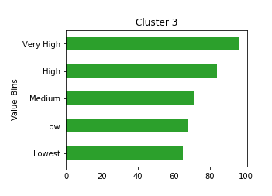

What about high value areas?
Cluster 3, which is most concentrated in Central London – hotels, restaurants and places for workers to grab lunch - was the only cluster to skew (slightly) towards high value properties.
We suggest that that venue category alone is not enough to distinguish one area from another.
  We suggest further work to refine our data to account for venue rating and/or price tier (£ to ££££) which will help distinguish between Michelin-star worthy restaurants and Kitchen Nightmares. This is a premium end-point on Foursquare’s API, and may require additional subscription.

Slide 7
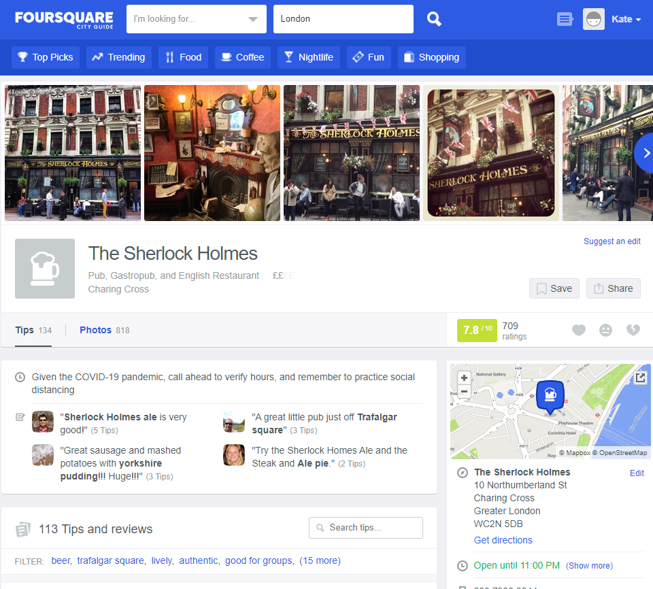

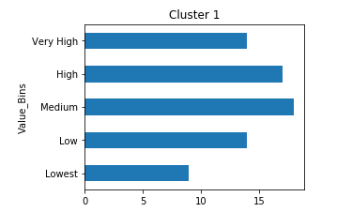
Decidedly Average – or - Stereotyping London
The histogram shows an almost normal distribution of house prices – possibly indicating that areas in Cluster 1 represent ‘average’ London. Cluster 1 is also fairly evenly spread throughout Greater London, including the centre.
There cannot be a more typically London venue than the classic London Pub – and it’s Pubs that are the top feature in this Cluster.

